Slide 1
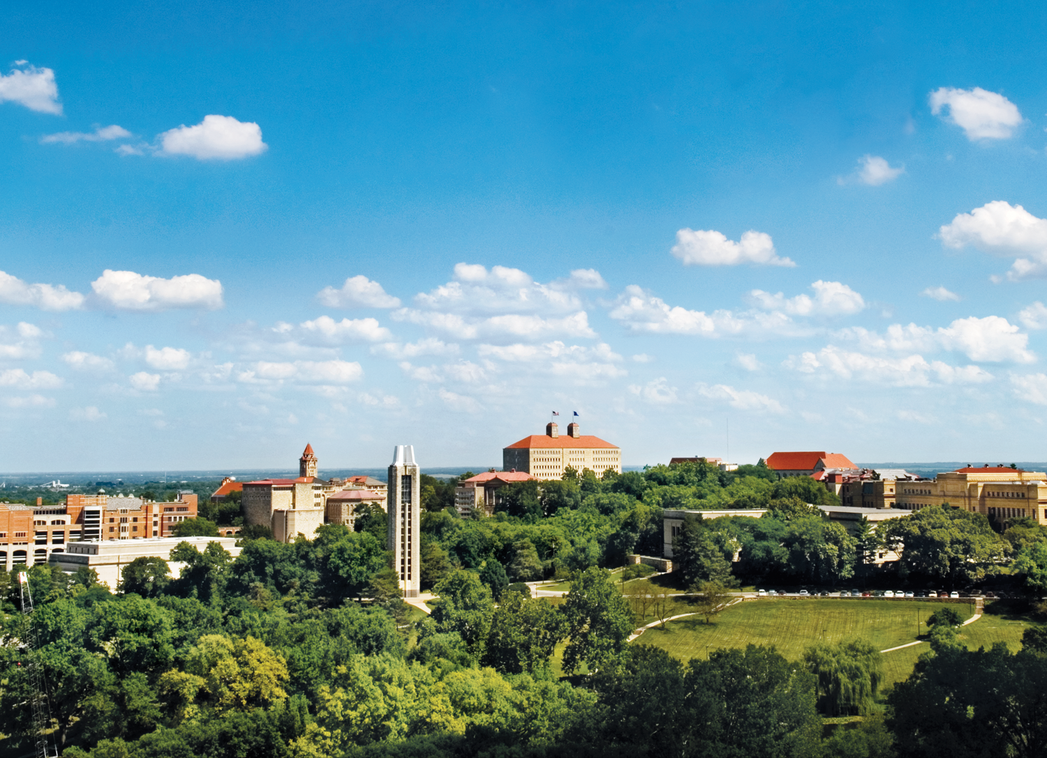
Building a Solid Foundation: Advancement through Strategic Communication
Rebecca Smith
University of Kansas Libraries
ALADN 2013

Slide 2
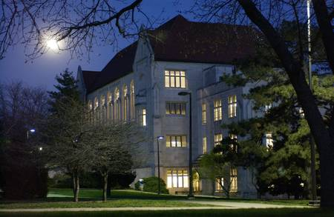
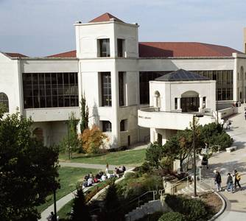
University of Kansas
26,266 students
2,617 faculty members
170 fields of study in 14 schools
$1.8 billion endowment
$1.2 billion campaign
235,000 alumni

Slide 3
KU Libraries
AAU member
ARL member
CRL member
4.2 million items
55 faculty
36 professionals
76 support staff
Notes:
Goals close the gap between the our preferred vision and our current situation.

Slide 4
Challenges to Overcome
No development director
Small library endowment
Disbanded friends group
Notes:
Goals close the gap between the our preferred vision and our current situation.

Slide 5
Highest Priorities
Create high visibility for KU Libraries
Establish legitimacy with Endowment
Re-establish communication with donors
Build a donor base
Notes:
Goals close the gap between the our preferred vision and our current situation.

Slide 6
Strategic Communications
A communications plan:
Identifies stakeholders
Establishes communications objectives
Hones message strategy
How it works:
Calculated effort to send targeted messages to audiences
Driven by vision and mission
Notes:
Goals close the gap between the our preferred vision and our current situation.

Slide 7
Strategic Communications
Why is a communications plan important?
Considers objectives and timing
Establishes consistency and coordination
Increases message clarity to improve effectiveness
Provides guidelines for evaluating a PR program
Notes:
Goals close the gap between the our preferred vision and our current situation.

Slide 8
Creating a Plan
Develop a strategy
Audiences (stakeholders)
Goals
Key messages
Timeline
Devise tactics
Publications
Events
Media relations
Organize information
Evaluate success
Notes:
Goals close the gap between the our preferred vision and our current situation.

Slide 9
Donor Demographics
Current donors or lapsed library donors
Collections or other in-kind contributions
Monetary contributions
Annual gifts and major gifts

Slide 10
Donor Demographics
Potential donors in the following areas:
Parents
Corporate partners
KU alumni
Former student assistants, faculty and staff
Friends and other who have self-identified

Slide 11
Donor Snapshot – Pre-Engagement
Library donors
0.5% percent of KU alumni had made a gift prior to 2007
Significant room for improvement
Geographic distribution
63 percent of donors were in state
Half of those donors lived within driving distance of KU

Slide 12
Donor Snapshot – Pre-Engagement
Average gifts (adjusted)
Average gift of Kansas donors - $110
Average gift of Lawrence area donors - $230
High potential with 400 local friends and donors

Slide 13
Communications Goals
Establishing clear goals:
Maintains clarity
Sets assessment standards
Keeps you and your outreach program focused

Slide 14
Communications Goals
Questions to ask:
Why are we addressing this group?
What are we trying to communicate?
What do we need to accomplish?
What’s the best possible outcome?

Slide 15
Communications Goals
Increase awareness of giving opportunities and outcomes
Increase awareness of impact to campus, community and state
Increase awareness of resources
Build prestige and reputation
Promote opportunities to engage

Slide 16
Key Messages
What are the top three to five things your stakeholders must know?
Key messages ensure consistency across outreach efforts with ease:
Publications
Releases and media interviews
Written and interpersonal communication
Repetition builds recognition

Slide 17
Key Messages
A successful library means a successful university.
KU Libraries are home to unique collections and other giving opportunities that enable you to support a permanent historical record.

Slide 18
Key Messages
Supporting KU Libraries means providing access to a world of ideas.
Supporting the Libraries means your gift has tremendous reach and longevity across campus.

Slide 19
Communications Planning
A tactical communications plan:
Serves as a practical roadmap
Connects key messages with stakeholders
Creates an organized framework

Slide 20
Tactical Plans
A tactical plan:
Outlines outlets, events and other ways to reach stakeholders
Utilizes existing resources to minimize costs and maximize reach
Allows for outreach efforts tailored to specific audiences
Can be expanded and updated regularly
Is a huge amount of work…but absolutely worth it

Slide 21
Tactical Plan Layout
Tactic | Type | Audience | Timing | Sponsor | Contact | Email
Bibliophile | Newsletter | Donors and friends | July and December | Libraries | Rebecca Smith | rasmith@ku.edu
Kansas Alumni | Magazine | Alumni Association members, donors | March, June, September, December | Alumni Association | Steven Hill | hill@kuaa.org
KU Connections | E-Newsletter | Alumni Association members, donors | Monthly, Deadline 25th | Alumni Association | Chris Lazzarino | lazzarino@kuaa.org
KU Giving | Magazine | Donors | February, May, August, November | Endowment Association | Kirsten Bosnak | bosnak@kuea.org
Spencer E-News | E-Newsletter | Donors and friends | Monthly, Deadline 5th | Spencer Museum of Art | Bill Woodard | woodard@sma.org
Communique | Newsletter | Donors and friends | May and November | Hall Center for the Humanities | Victor Bailey | hallcenter@ku.edu

Slide 22
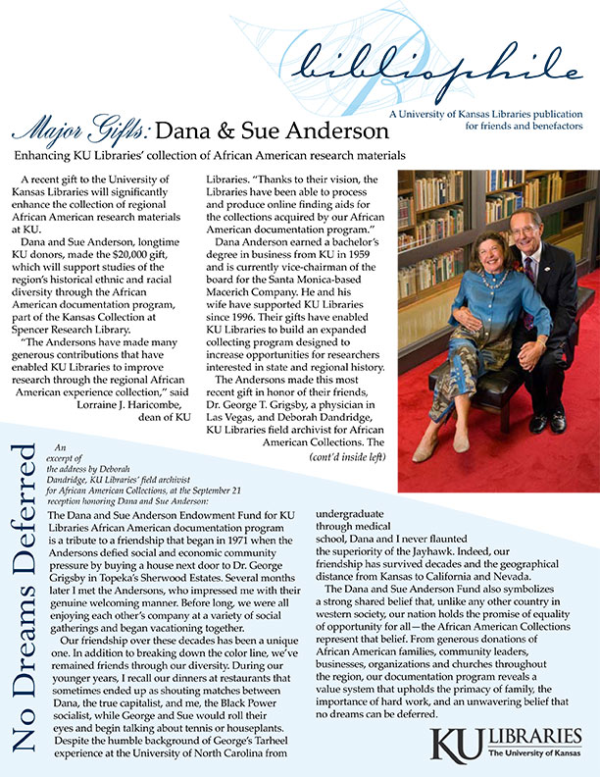
New Tactics
Publications
Letters from the dean
Donor newsletter - 2/year
Annual report
Marketing
Web development
Promotional materials
READ campaign
Social media

Slide 23
New Tactics
Media Relations
Focused primarily on local media outlets
Created releases with communication goals in mind
Incorporated key messages
Provided one-on-one media training to staff

Slide 24
New Tactics
Events
Family Weekend & Homecoming
Reading festival
Retooling existing events
Donor recognition
Follow-up

Slide 25
Assessment
Success determined by increased:
Communication with stakeholders
Dissemination of targeted messages
Media coverage in targeted outlets
Opportunities for outreach

Slide 26
Initial Markers of Success
Expanded media coverage
200 media hits in 18 months (up from 10)
Key messages present in a vast majority of proactive coverage

Slide 27
Initial Markers of Success
Expanded outreach
17 special events in 18 months
Attendance steadily grew from 20-30 people per event to 60-70, with many returning
Survey responses showed growing affinity

Slide 28
Initial Markers of Success
Acquired a half-time development director
Increased local engagement
Launched new national engagement program
Significant increase in contributions in next FY

Slide 29
Continued ROI
Donor data snapshot - 2012
Percentage of alumni giving up 300 percent
Lawrence average gift amount was up 25 percent (adjusted)
Kansas average gift amount was up 28 percent (adjusted)

Slide 30
Giving to KU Libraries
As of
May 2013
The KUEA gift productivity report was used to pull these numbers.

Slide 31
Notes:
A TOOL FOR ORGANIZATIONAL CHANGE
1980 Cleveland Clinic Project at Case Western University.
The velocity of the largely informal spread of the ideas associated with Appreciative Inquiry suggests a growing disenchantment with exhausted theories of change, especially those wedded to vocabularies of human deficit, and a corresponding urge to work with people, groups, and organizations in a more constructive, life affirming, strength-based and spirited way.
reframing topics from an appreciative perspective.
dialogue about the great things taking place in

